Slide 1
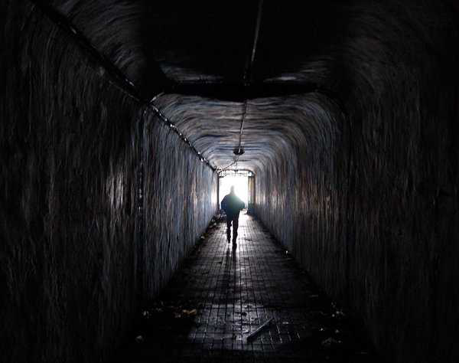
The End of the Tunnel ☺

Slide 2
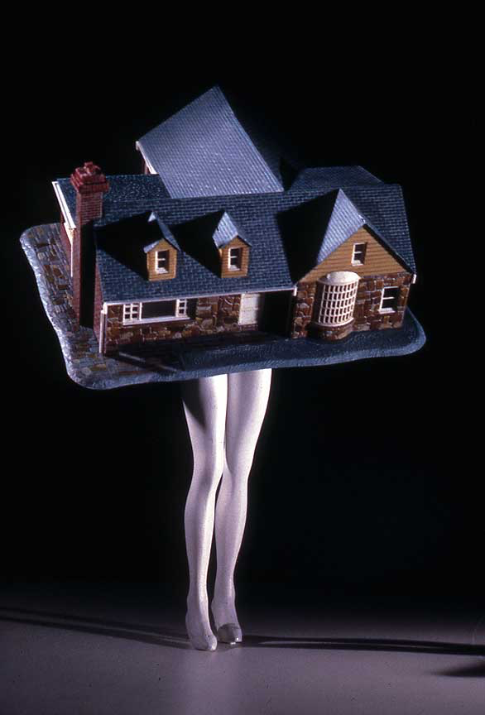
Walking House (Color)" (1989)
Laurie Simmons
This is the artist I selected to base my final off of.
-Referring back to 50s
-Using human body with unnatural characteristics that say something about the individual
-Combination of elements, Collage, Pastiche
*Creates a sense of nostalgic

Slide 3
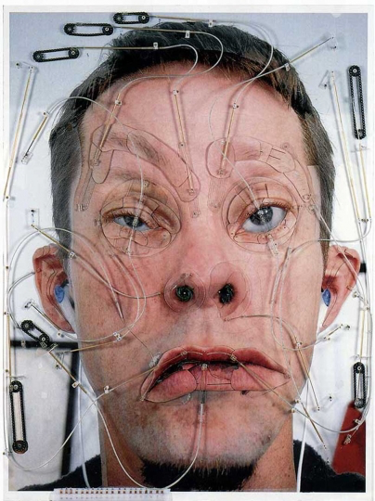
Emoter," detail (2000)
Tim Hawkinson
-Focuses on personal traits of himself
-Uses his body often in his work and through his process sees how he can make changes
-Emotor is constantly changing his face expressions, mostly to faces he cannot actually make
-Combination of elements, pastiche
*Relationship between altering our actual being in this world

Slide 4
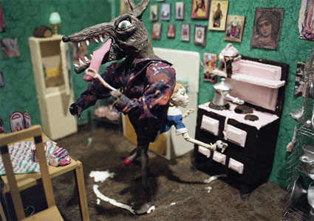
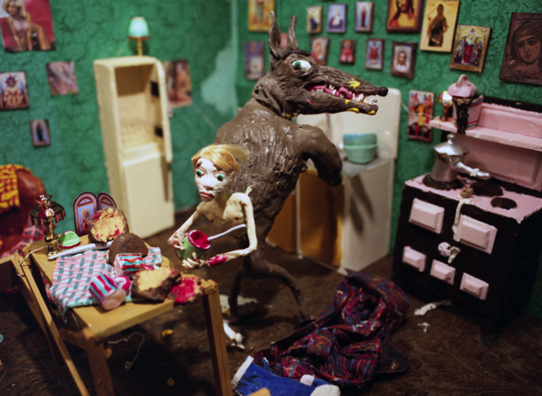
We Are Not Two, We Are One, 2008 Still
Nathalie Djurberg
-she focuses on social and political issues
is something Im not very concerned about consciously but it appears in my final
-she create fantasy like worlds
-she combines human desires into her clay animated films: lust, sex, revenge etc
-combination, pastiche

Slide 5
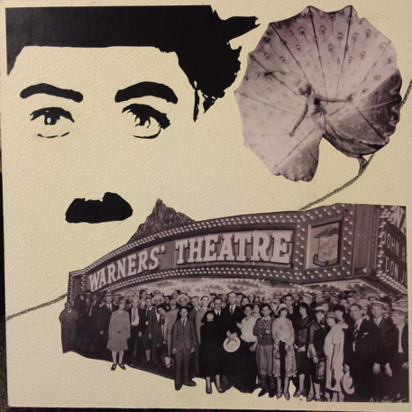
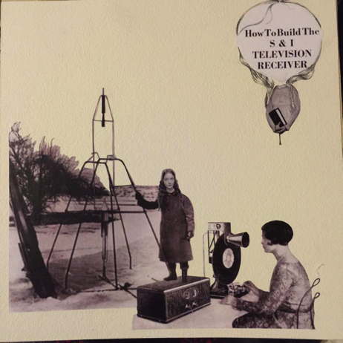
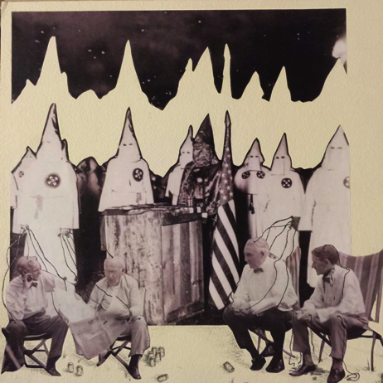
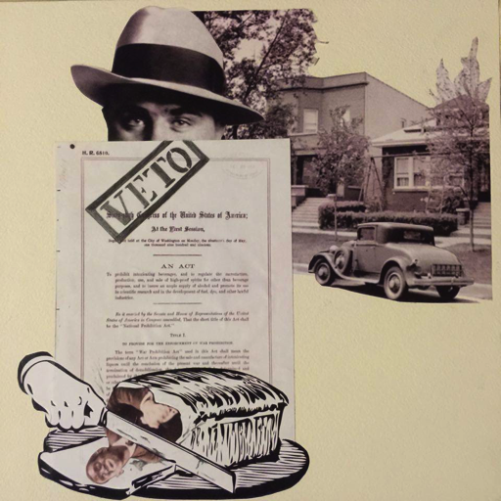
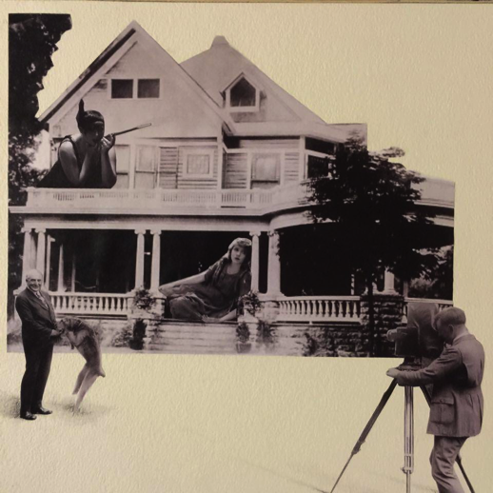

Slide 6
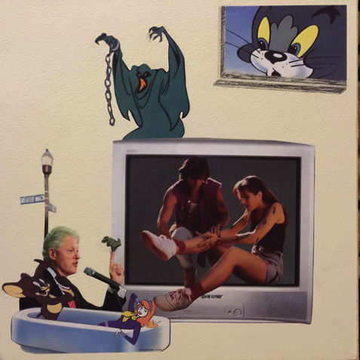
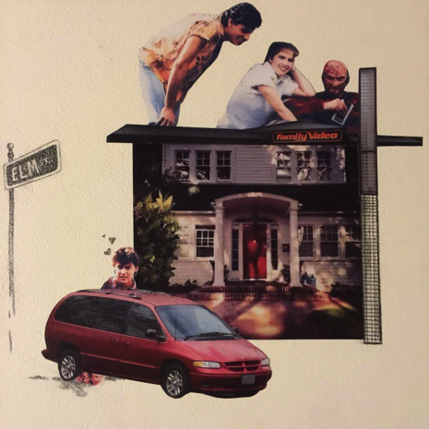
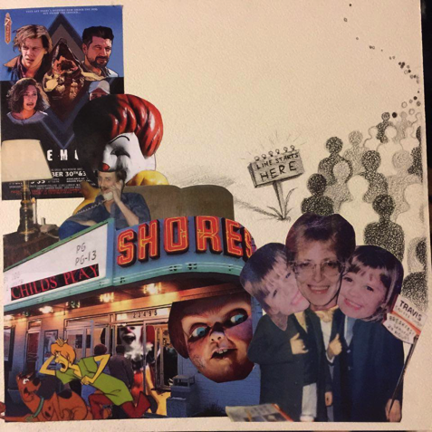
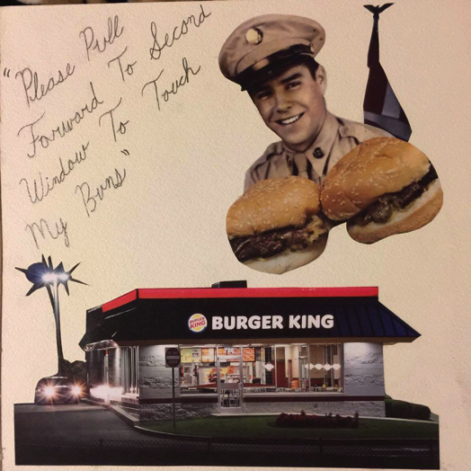
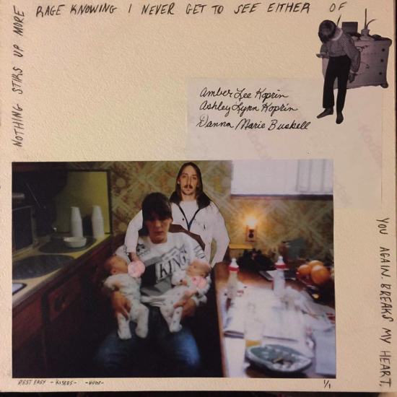

Slide 7
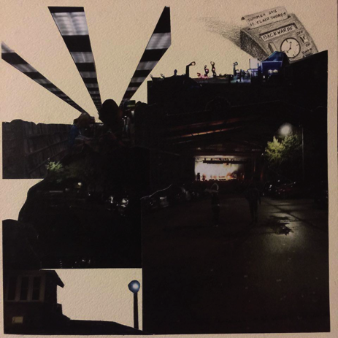
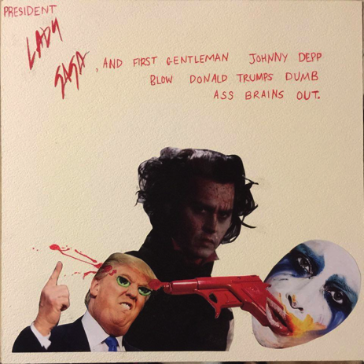
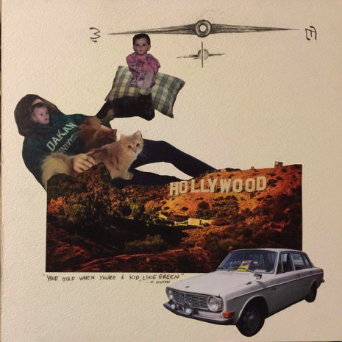
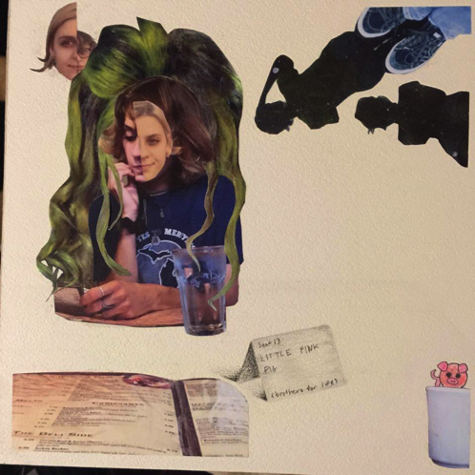
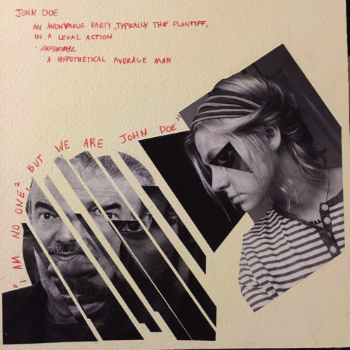

Slide 8
Works Cited
http://www.pbs.org/art21/images/laurie-simmons/walking-house-color-1989?slideshow=1
http://www.art21.org/texts/tim-hawkinson/interview-tim-hawkinson-drip-and-emoter
http://www.wexarts.org/exhibitions/human-behavior-nathalie-djurberg-music-hans-berg
https://www.google.cm/search?q=end+of+tunnel&biw=1163&bih=759&source=lnms&tbm=isch&sa=X&ved=0ahUKEwiVw-Ga36nMAhXksIMKHf6sBOcQ_AUIBigB

